Slide 1
8
Crime and Mental Disorders

Slide 2
Chapter Objectives
Define mental disorders.
Provide an overview of the DSM and the diagnoses that are most relevant to criminal behavior.
Define and review issues relating to competency to stand trial.
Review the insanity defense rules and standards.

Slide 3
Chapter Objectives
Discuss special defenses sometimes raised to absolve defendants of criminal responsibility or mitigate responsibility.
Discuss the prevalence of mental illness in incarcerated populations.

Slide 4
Chapter Objectives
Define risk assessment and identify the risk factors employed in assessing violent criminal behavior.
Explore the relationship between mental disorder and violence.

Slide 5
Defining Mental Illness: Code of Virginia § 37.2-100. Definitions
Mental illness Defined Code of Virginia
§ 37.2-100. Definitions
“Mental illness" means a disorder of thought, mood, emotion, perception, or orientation that significantly impairs judgment, behavior, capacity to recognize reality, or ability to address basic life necessities and requires care and treatment for the health, safety, or recovery of the individual or for the safety of others.

Slide 6
Defining Mental Illness: Code of Virginia § 37.2-100. Definitions
"Intellectual disability" means a disability, originating before the age of 18 years, characterized concurrently by (i) significant subaverage intellectual functioning as demonstrated by performance on a standardized measure of intellectual functioning, administered in conformity with accepted professional practice, that is at least two standard deviations below the mean and (ii) significant limitations in adaptive behavior as expressed in conceptual, social, and practical adaptive skills.

Slide 7
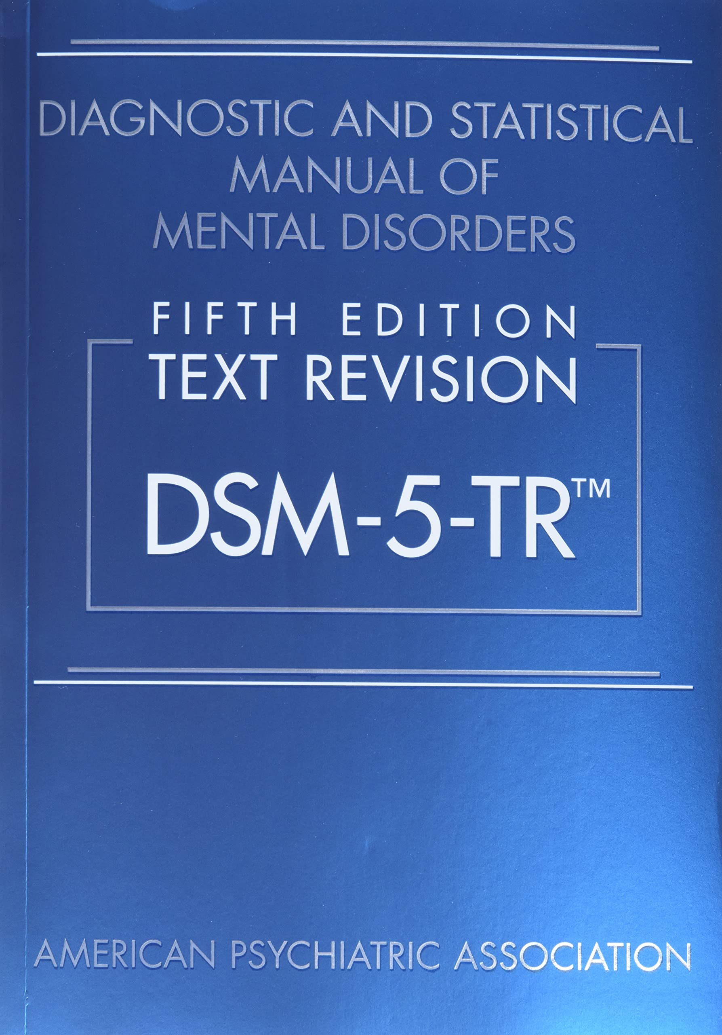
Diagnosing Mental Illness
The Diagnostic and Statistical Manual for Mental Disorders, 5th Edition.
(DSM 5)
The guidebook for clinicians seeking to define and diagnose specific mental disorders
Published in 2013 with a Text Revision published in 2022 (DSM 5-TR)
American Psychiatric Association
But all mental health professions use it

Slide 8

Mental Illness and the Criminal Justice System (3:15)

Slide 9
Mental Illness & Crime
Mental illnesses are common in the United States. Nearly one in five U.S. adults live with a mental illness (52.9 million in 2020). Some of these illnesses are severe and some are less severe. (NIMH, 2022)
NIMH defines Serious Mental Illness as, “a mental, behavioral, or emotional disorder resulting in serious functional impairment, which substantially interferes with or limits one or more major life activities.” (NIMH, 2022)

Slide 10
Mental Illness & Crime
The percentage of persons in correctional institutions with serious mental illnesses far exceeds the percentage in the general population. It is estimated that approximately 20% of inmates in jails and 15% of inmates in state prisons have a serious mental illness while the estimated percentage of persons with serious mental illness in the general public was estimated to only be 5.6%

Slide 11
Mental Illness & Crime
People with serious mental illness are booked into jails approximately 2 million times each year.
It is possible to have more than one of the diagnosable mental disorders at the same time, (dual diagnosis, co-morbidity), and many incarcerated individuals fall into this category.
Substance abuse is a common accompanying condition
Diagnoses can be wrong

Slide 12
Mental Illness & Crime
Mentally ill inmates remain in jail longer than inmates without mental illnesses. In Florida’s Orange County Jail, the average stay for all inmates is 26 days; for mentally ill inmates, it is 51 days. The main reason mentally ill inmates are incarcerated longer than other prisoners is that many find it difficult to understand and follow jail and prison rules and are twice as likely to be charged with rules violations. (Treatment Advocacy Center, 2016)
Mentally ill inmates are much more likely to attempt suicide while incarcerated than are inmates without a mental illness. A 2002 study in the state of Washington found that “the prevalence of mental illness among inmates who attempted suicide was 77%, compared with 15% of the general jail population.

Slide 13
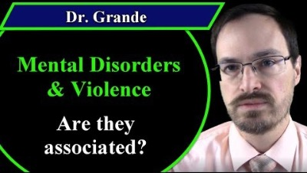
Mental Illness & Crime (6:58)

Slide 14
Defining Mental Illness
Mental disorders that are most likely to be associated with criminal conduct
Persons with these disorders are not "crime prone."
Even if an individual is diagnosed with these disorders, he or she still can be held responsible for criminal conduct.
The diagnosis alone is not sufficient to escape punishment.
Must show cognitive incompetency

Slide 15
Mental Illness & Crime
Mental disorders that are most likely to be associated with criminal conduct
Schizophrenia spectrum and other psychotic disorders
Bipolar disorder
Major depression
Antisocial personality disorder

Slide 16
Schizophrenia (DSM 5)
Two (or more) of the following, each present for a significant portion of time during a 1-month period (or less if successfully treated). At least one of these must be delusions, hallucinations or disorganized speech:  Delusions
 Hallucinations  Disorganized speech (e.g., frequent derailment or incoherence)  Grossly disorganized or catatonic behavior  Negative symptoms (i.e., diminished emotional expression or avolition)
Schizophreniform disorder is very similar to schizophrenia, but symptoms last for 1 to 6 months. If the symptoms last longer than 6 months, a doctor may diagnose schizophrenia.

Slide 17
Schizophrenia Spectrum and Other Psychotic Disorders
Schizotypal disorder (NOT schizotypical as in textbook)
People with schizotypal personality disorder are often described as odd or eccentric and usually have few, if any, close relationships. They generally don't understand how relationships form or the impact of their behavior on others. They may also misinterpret others' motivations and behaviors and develop significant distrust of others. (Mayo Clinic, 2019)
Schizoaffective disorder
a mental health disorder that is marked by a combination of schizophrenia symptoms, such as hallucinations or delusions, and mood disorder symptoms, such as depression or mania (Mayo Clinic, 2019)
Schizoid Personality Disorder
Schizoid personality disorder is an uncommon condition in which people avoid social activities and consistently shy away from interaction with others. They also have a limited range of emotional expression.

Slide 18
Schizophrenia Spectrum and Other Psychotic Disorders
Proportion of violent crimes is small, but level of violence is higher when they do commit a violent crime.
Risk is transitional. More likely when person is experiencing psychosis.
“If a person has a severe mental illness, [they] may have other risk factors for violent behavior,” he says. “So, it may not be mental illness that is driving the violence at all, but rather factors like having been abused as a child, being unemployed, or living in a high-crime neighborhood.” (American Psychological Association, 2022)

Slide 19
Bipolar Disorder
Bipolar disorder is a severe and prevalent psychiatric disease. Poor outcomes include a high frequency of criminal acts, imprisonments, and repeat offenses. (Psychiatry Online, 2015)
Mood disorder
Manic phase
Euphoria, hyper-energy, and distractibility
Depressive phase
Diminished interest or pleasure in all activities and depressed mood

Slide 20
Bipolar Disorder
Bipolar I vs Bipolar II
No mania, or hypo mania, in Bipolar II
Reckless behavior that leads to criminal activity during manic phase
Associated impulsivity may be related to criminal activity

Slide 21
Major Depressive Disorder
Extremely depressed state that lasts for at least two weeks
A generalized slowing down of mental and physical activity, gloom, despair, feelings of worthlessness, and perhaps frequent thoughts of suicide
Suicide by Cop, mass murder
Delinquency in teenage girls
People with a depressive illness are three times more likely to commit a violent or sex crime than those in the general population, a study suggests. (Dept of Psychiatry U of Oxford, 2015)
The don’t care about what happens to them so why should they care about what happens to someone else?

Slide 22
Antisocial Personality Disorder
A history of continuous behavior in which the rights of others are violated (crime)
At least 18 years of age and must have a history of some symptoms of conduct disorder before age 15
Impulsivity, lack of empathy, deceitfulness
Common diagnosis of offenders
Maybe because part of the diagnosis requires committing a crime?

Slide 23
Substance Abuse Disorder
In co-morbid disorders where substance abuse is one of the conditions, the risk of violence goes up dramatically.
For schizophrenia, the risk with schizophrenia alone for violence is 2x the unaffected public
Add substance abuse and the risk goes to 9x

Slide 24
Borderline Personality Disorder
Key symptoms that might be related to criminal behavior (most will not act in a criminal manner):
High sensitivity to rejection and feelings of alienation or isolation
Reaction to the rejection?
Intense and highly variable moods
Rapid cycling between love and hate
Difficulty in regulating emotions in general
Inappropriate, intense anger or problems controlling anger

Slide 25
Borderline Personality Disorder
Tend to see things in terms of only either/or
Only good or bad, no in between
Engaging in impulsive behaviors/no self-control
Lashing out
May be violent

Slide 26
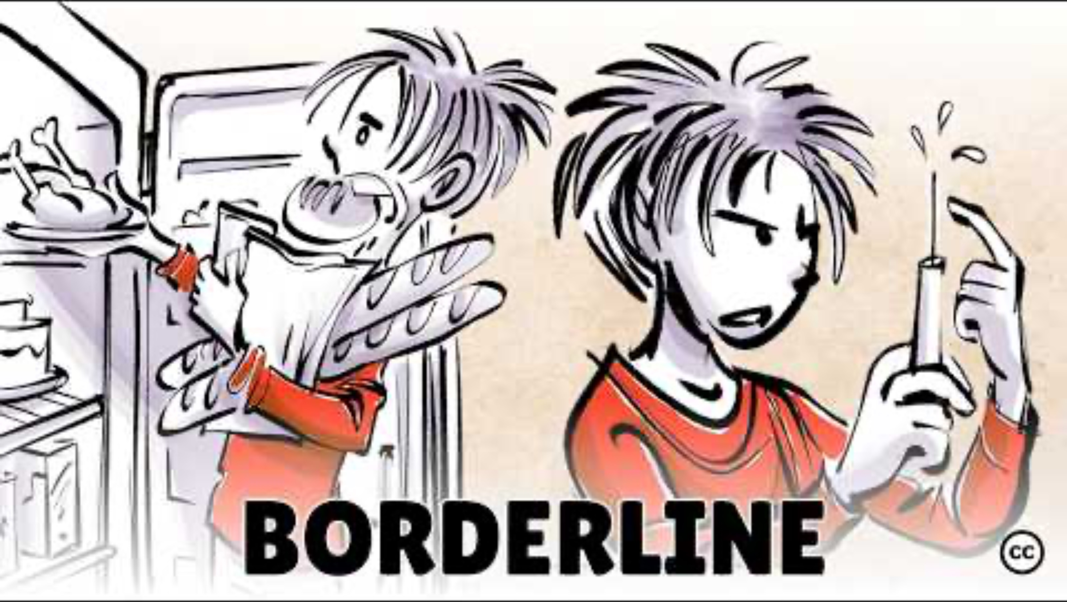
Borderline Personality Disorder

Slide 27

Competency in the Criminal Justice System (8:26)

Slide 28
Competency
Two types of mental competency come into play in judicial hearings in criminal cases. (We will not be discussing civil competency hearings)
Competency to stand trial
Competency at the time of the offense
A person could be found incompetent to stand trial but competent at the time of the offense,
What do you think happens then?
Burden of proof on defendant
Usually have to plead guilty first
Is this fair?

Slide 29
Competency
Incompetency to stand trial
State of Mind NOW
Not at the time of the offense
Dusky v. United States (1960)
A lack of understanding of court proceedings, one's rights, or the functions performed by one's lawyer
Too impaired to participate in one’s own defense
80% of those evaluated are found competent

Slide 30
Competency
Incompetency to stand trial
What is the defendant's state of mind at the present time, or at the time of the pretrial proceedings or trial?
Jackson v. Indiana (1970)
What if you cannot be made competent to stand trial by treatment after a lengthy period of time?
Must release from criminal custody, but can commit under civil procedures

Slide 31
Competency
Incompetency to stand trial
Sell v. United States (2003)
Does it violate the 5th Amendment to force a person that is incompetent to stand trial to take medication to make them competent to stand trial?
If you are untreated and will not otherwise be competent to stand trial, they would have to release you from criminal custody.
Sell decided the state has a right to force medication IF the person is charged with a serious VIOLENT crime.

Slide 32
Criminal Responsibility
If an insanity defense is successful, it will result in one of two outcomes:
Not Guilty By Reason of Insanity (NGRI)
Guilty but Insane
Outcomes are quite different
NGRI: hospitalized but could be released without further involvement with the criminal justice system if restored to competency.
Guilty but insane: hospitalized and if restored to competency, serve the rest of the sentence in prison
In both cases, if not restored to competency, may stay in custody for ever, so may get longer term.

Slide 33
Criminal Responsibility
Not guilty by reason of insanity (NGRI)
A person's state of mind at the time an offense was committed
Rationale is that a person with a serious mental illness cannot establish Mens Rea (remember required elements of a crime)
Not all mental disorders render a person incapable of establishing Mens Rea

Slide 34
Criminal Responsibility
Not guilty by reason of insanity (NGRI)
Media coverage always abundant when a finding of NGRI is made in a prominent case
A small proportion of criminal cases
No systematic, nationwide data
Used in only 1% of all U.S. felony criminal cases
Estimates are much higher for misdemeanor offenses (22-25%)

Slide 35
Insanity Standards
No single standard for insanity defense in the US. Each state, and the federal government can establish their own rules.
It is not required that a state have an insanity defense (Kahler v. Kansas, 2020, 6-3 decision).
Kansas, Utah, Montana and Idaho do not have provisions for this.
Do you think this is fair?

Slide 36
Insanity Standards
M'Naghten Rule
Formulated in 1843
Not in the US but in Scotland
Used by about half the states
Right and wrong test
Did the person know the difference between right and wrong at the time of the offense, not at the present time
Irresistible impulse test sometimes added on to M’Naghten
Knew act was wrong but driven by irresistible forces and just could not stop committing the act
Ex. Parent catches someone sexually molesting their child and then immediately beats them to death with a bookend.

Slide 37
Virginia Insanity Standards
In Virginia, the legal code does not directly define insanity; the current definition of insanity in Virginia was established through case law, or historical court cases. (Virginia Dept of Behavioral Health).
Commonwealth of Virginia uses the M’Naghten rule plus irresistible impulse standard.

Slide 38
Insanity Standards
The Brawner Rule (1973) and the American Law Institute Rule
Used by 20 states & federal courts (HG Legal, 2023)
“A person is not responsible for criminal conduct if at the time of the action, as a result of mental disease or defect, he/she lacks substantial capacity either to appreciate the criminality of his conduct to the requirements of the law.” This rule makes it clear that any “mental disease or defect” does not include the manifestation of mental illness due to repeated criminal acts throughout their life.” (HG Legal, 2023)
So, claiming Antisocial Personality Disorder would not work
Includes irresistible impulses

Slide 39
Insanity Standards
The Durham Rule: The Product Test
Assumes that one cannot be held responsible if an unlawful action is the product of mental disease or defect.
Vague and subjective
What mental disease?
Would the state have to let all DUI drivers go to treatment instead of jail if they proved they were alcoholics?
Only used by one state: New Hampshire

Slide 40
Insanity Standards
The Insanity Defense Reform Act (IDRA)
Response to John Hinkley case
Similar to M’Naughten but behavior has to be linked to a mental condition
In federal cases, experts can only testify to findings, diagnosis of mental conditions, but not opinions about sanity
Can state someone has Schizophrenia but cannot state they believe that person is insane

Slide 41
Unique Defenses and Conditions
Posttraumatic stress disorder
Between 1 and 7% all Americans
Military veterans have higher rates.
Used to support NGRI defense
Dissociated state
Battered woman syndrome
More unsuccessful claims of NGRI for PTSD than successful one

Slide 42
Unique Defenses and Conditions
Dissociative identity disorder
Multiple personality disorder
The presence of two or more distinct personality states or an experience of possession and recurrent episodes of amnesia
Validity is debated
Low success rates in claiming NGRI
The rate of dissociation in the general public is also very low

Slide 43
Unique Defenses and Conditions
Dissociative amnesia
Complete or partial memory loss of an event, series of events, or some segment of life's experiences, either due to physical trauma, neurophysiological disturbance, or psychological factors, or alcohol/drugs
Just because you cannot now recall the event, were you conscious about it and the repercussions when it was done?
How would you prove it?
Burden of proof is on you.

Slide 44
Mental Disorder and Policing
Police and the mentally disordered
Currently, many jurisdictions are rethinking having police respond to mental health crises
What if a trained person is too far away?
Police may fail to recognize behavior as representing a mental disorder.
Police should focus on behavior and not on diagnosis
Change tone of voice
Reduce speed of questioning
Speed is not always of the essence
Don’t make a minor crisis a major one

Slide 45
Mental Disorder and Policing
False confessions during interrogations
Improper use of Reed Technique
Some disorders affect comprehension and response may not reflect reality due to a lack of understanding
Both of the above lead to a higher percentage of false confessions from mentally ill persons during interrogations.
Some jurisdictions, such as Fairfax County locally have created diversionary systems for mentally ill persons involved in minor crimes
Not everyone needs to go to jail

Slide 46
Mental Disorder and Jails
Mentally disordered inmates
Research indicates that the percentage of mentally disordered inmates in the nation's jails and prisons is increasing.
Clinical diagnoses are difficult to determine.
Not enough clinicians
Not enough time spent per inmate
Revolving door
Costing jurisdictions a lot of money

Slide 47
Mental Disorder and Jails
Mentally disordered inmates
Jails may make existing mental conditions worse
May create new mental health conditions in previously unaffected persons
Supermax prisons are almost all solitary confinement
Pennsylvania system in early 1800’s
Produced psychotic persons from solitary confinement with no interpersonal contact

Slide 48
Duty to Warn Virginia Code
A mental health service provider has a duty to take precautions to protect third parties from violent behavior or other serious harm only when the client has orally, in writing, or via sign language, communicated to the provider a specific and immediate threat to cause serious bodily injury or death to an identified or readily identifiable person or persons, if the provider reasonably believes, or should believe according to the standards of his profession, that the client has the intent and ability to carry out that threat immediately or imminently. (§ 54.1-2400.1: B)

Slide 49
Dangerousness and the Assessment of Risk
The Tarasoff case
California case, not national case law
Duty to warn or protect
Assumes one can predict threat with accuracy
This makes these laws vague in many cases: See Virginia Code next slide.

Slide 50
Dangerousness and the Assessment of Risk
Violence risk factors and measures
Actuarial approach
Almost just a check list
Unstructured clinical approach
Extremely subjective
Structured professional judgment
Clinical and actuarial approaches
Some have argued they are racially biased
Actuarial has best validity based on research
Still lacking
Best predictor of future violent behavior is past behavior regardless of mental health status

Slide 51
Other Resources
Text:
Defining Mental Illness: Code of Virginia§ 37.2-100. Definitions (2011) https://law.lis.virginia.gov/vacodefull/title37.2/chapter1/.
National Institute of Mental Health (NIMH). Mental Illness. (January 2022). https://www.nimh.nih.gov/health/statistics/mental-illness
Treatment Advocacy Center. Serious Mental Illness Prevalence in Jails and Prisons. (Sept 2016). https://www.treatmentadvocacycenter.org/evidence-and-research/learn-more-about/3695
DeAngelis, T. Mental illness and violence: Debunking myths, addressing realities. American Psychological Association. (2022) https://www.apa.org/monitor/2021/04/ce-mental-illness
Fovet, T. M, Geoffroy, P, Vaiva, G, Adins, C, Thomas, P, Amad, A. Individuals With Bipolar Disorder and Their Relationship With the Criminal Justice System: A Critical Review. Psychiatry Online (2015) https://ps.psychiatryonline.org/doi/10.1176/appi.ps.201400104
Depression linked to Violent Crime Study Finds. Department of Psychiatry University of Oxford. (2015) htStps://www.psych.ox.ac.uk/news/depression-linked-to-violent-crime-study-finds
Schizoaffective Disorder. Mayo Clinic. (2019) https://www.mayoclinic.org/diseases-conditions/schizoaffective-disorder/symptoms-causes/syc-20354504
Schizotypal Disorder. Mayo Clinic. (2019) https://www.mayoclinic.org/diseases-conditions/schizotypal-personality-disorder/symptoms-causes/syc-20353919

Slide 52
Other Resources
Text:
Mayo Clinic. Schizoid Personality Disorder. (2019) https://www.mayoclinic.org/diseases-conditions/schizoid-personality-disorder/symptoms-causes/syc-20354414
United States Supreme Court, Kahler v. Kansas, Oyez. (2020) https://www.oyez.org/cases/2019/18-6135
Virginia Department of Behavioral Health & Developmental Services. Insanity Defense and NGRI Finding.(2022) https://dbhds.virginia.gov/wp-content/uploads/2022/09/Section-1-The-Insanity-Defense-Insanity-Finding.pdf
HG Legal. Insanity Defenses. (2023) https://www.hg.org/legal-articles/legally-insane-the-insanity-defense-34143
Code of Virginia § 54.1-2400.1 (B) Mental Health Service Providers Duty to Protect 3rd Parties. https://law.lis.virginia.gov/vacode/title54.1/chapter24/section54.1-2400.1/

Slide 53
Other Resources
Video:
Startling Number of Mental Patients Behind Bars in US. (2016) BBC News. https://www.youtube.com/watch?v=OT3ZlaVOhrc
What does it Mean to be Criminally Insane? (2021) Infographics. https://www.youtube.com/watch?v=UzGnD9sE0A4
Mental Disorders and Violence. (2018) Dr. Grande https://www.youtube.com/watch?v=MjGNleUGtfo
Sprouts (2024) Borderline Personality Disorder. https://www.youtube.com/watch?v=JYSX88h-qIc

